Slide 1
Popularity-Enhanced News Recommendation with Multi-View Interest Representation
Advisor: Jia-Ling, Koh
Speaker: Hsiang-Hui Chou
Source: CIKM ’21
Date:2022/06/07

Slide 2
Outline
Introduction
Method
Experiment
Conclusion

Slide 3
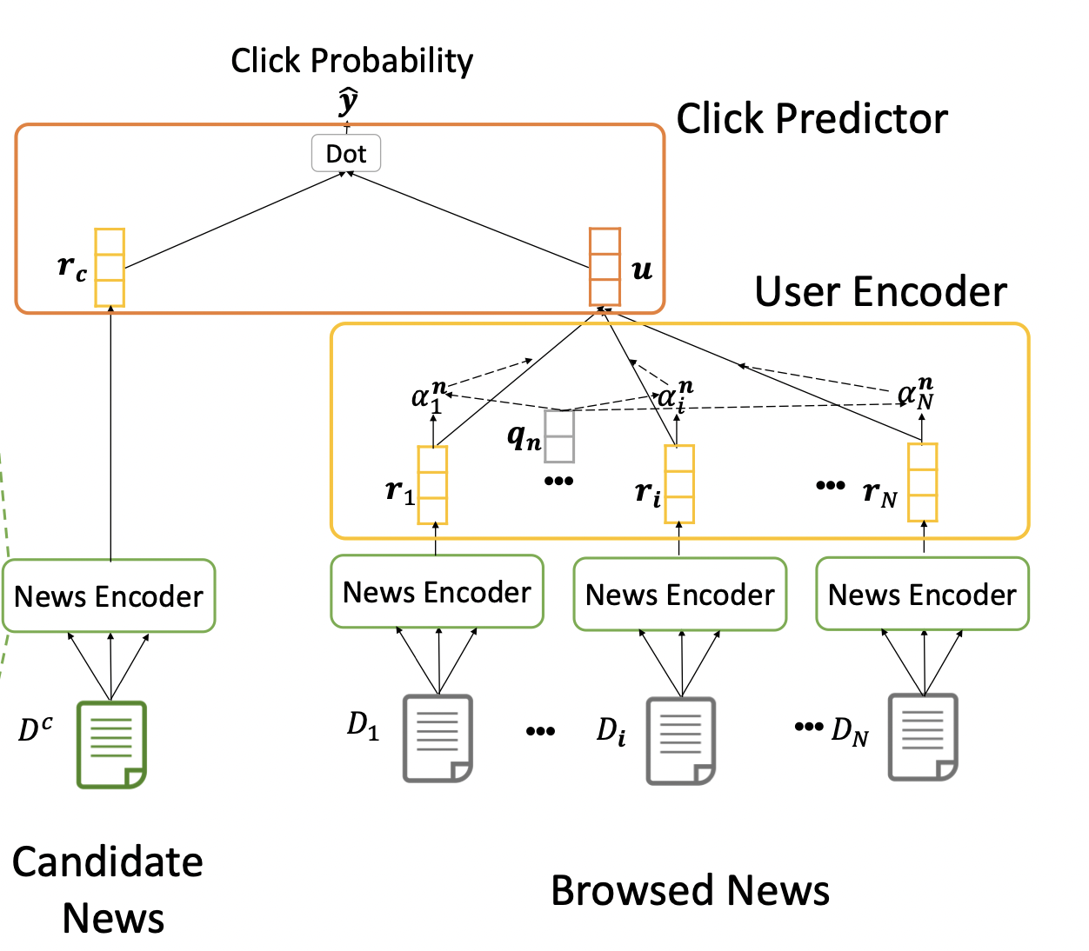
News Recommendation
Before
matching the final user vector with the candidate news vector
to predict Click Through Rate(CTR)
Click Through Rate(CTR) ：
the probability of a user clicking on the news
The framework of our NAML

Slide 4
News Recommendation
Problem
ignore the popularity of news
hard to represent user interests via a single user vector.
Solution: Popularity-Enhanced News Recommendation
add predict candidate news popularity score
capture users’ multi-view interest representations

Slide 5
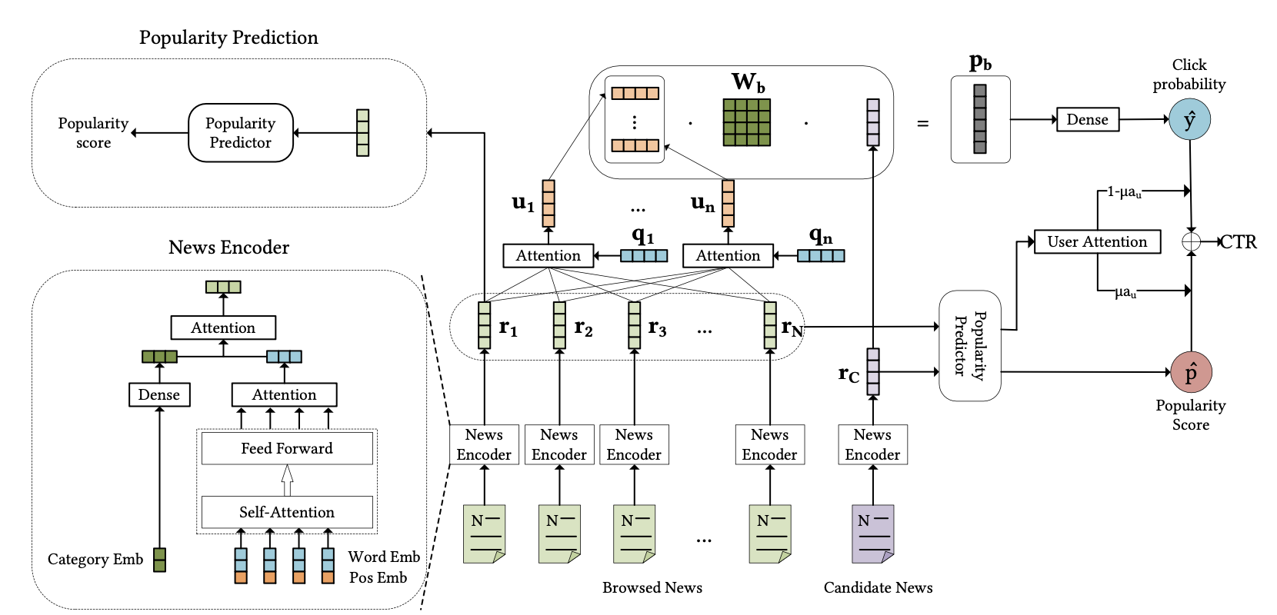
Input/Output
Input
A User browsing history
/Candidate news
news title
news abstract
news category
Output
CTR(Click Through Rate)
the probability of
a user clicking on the news

Slide 6
Outline
Introduction
Method
Experiment
Conclusion

Slide 7
Framework of PENR Popularity-Enhanced News Recommendation
3. Click Predictor
2. User Encoder
1. News encoder
4. Popularity Predictor

Slide 8
Framework of PENR
CTR (Click through rate)

Slide 9
1. News encoder

Slide 10
1. News encoder
News title and abstract encoder:
News title {w₁,w₂,….,w_{n})
{e₁,e₂,…,e_{n}}
convert each word into
its low-dimensional vector
Position information
New title:
See spectacular fall foliage in these national parks
{w₁,w₂,….,w_{n})
= {see, spectacular, ….,parks}

Slide 11
1. News encoder
News title and abstract encoder:

Slide 12
1. News encoder

Slide 13
2. User Encoder

Slide 14
2. User Encoder
a_{i,k} : attention weights of the k-th browsing news
u_{i} : user representation of the i-th aspect

Slide 15
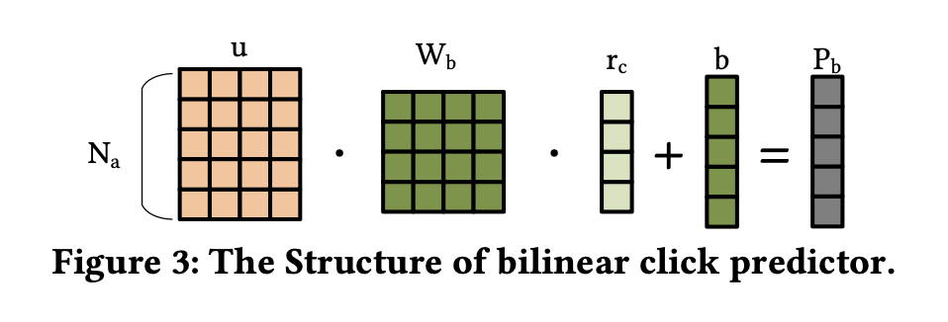
3. Click Predictor

Slide 16
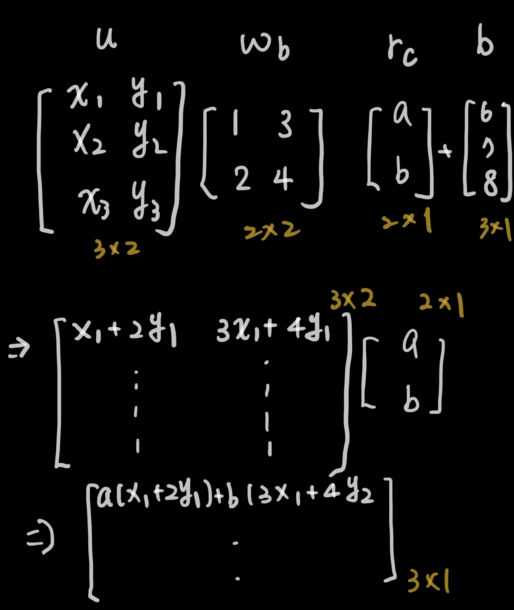
3. Click Predictor
Bilinear function

Slide 17
4. Popularity Predictor

Slide 18
4. Popularity Predictor & CTR
CTR with news popularity

Slide 19
4. Popularity Predictor & CTR
p_{h} : the predicted popularity of news in the click history

Slide 20
4. Popularity Predictor
News popularity :
->count the click behaviors in the dataset to approximate news popularity
Ex :
News : n1~n5
User 1 : 點過n1,n5
User2 : 點過n1,n4
User3 : 點過n1,n3,n4
maximum value :3
news | clicks | popularity
n1 | 3 | 3/3
n2 | 0 | 0/3
n3 | 1 | 1/3
n4 | 2 | 2/3
n5 | 1 | 1/3

Slide 21
Loss function
Given a user u and candidate news c
compute the click probability score denoted as Sˆu,c

Slide 22
Loss function
indicates the probability that vector u_{i} belongs to each subspace

Slide 23
Outline
Introduction
Method
Experiment
Conclusion

Slide 24
Experiment
user click logs of Microsoft News

Slide 25
Experiment

Slide 26
Experiment

Slide 27
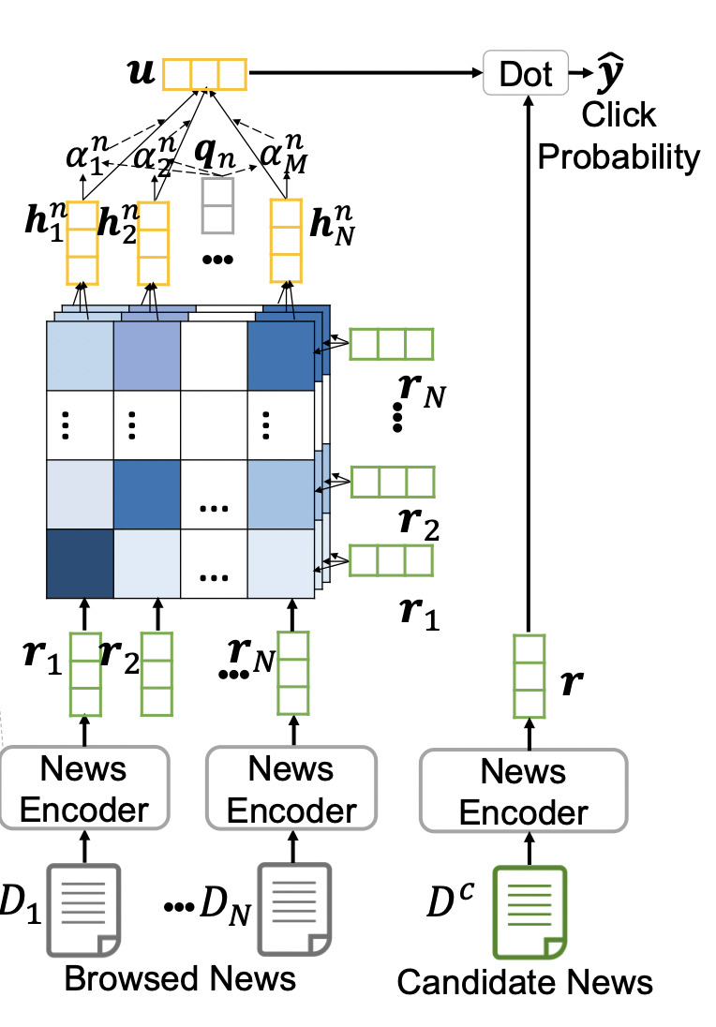
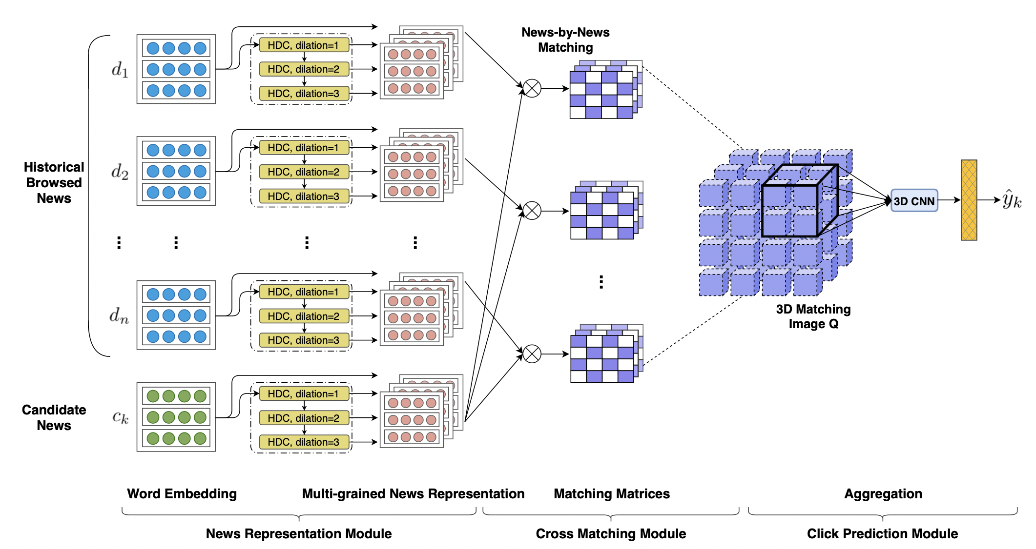
Experiment
NRMS(without popularity)
FIM (without popularity)
HDC (hierarchical dilated convolution) is the news encoder

Slide 28
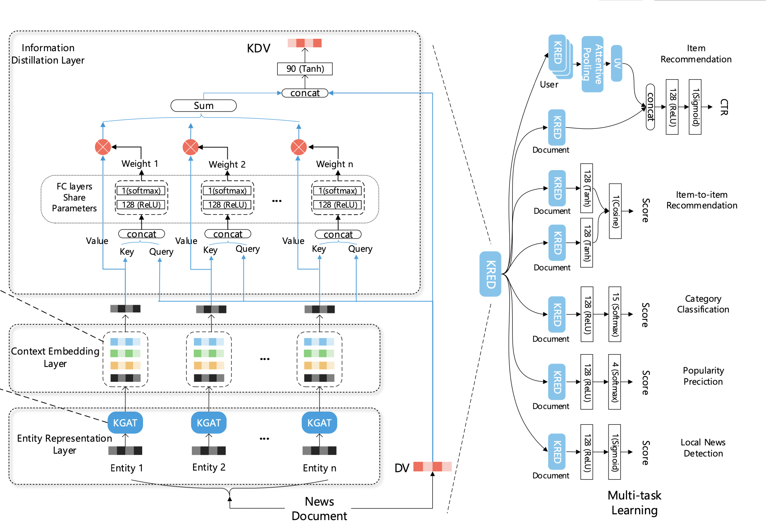
Experiment
KRED (with popularity)

Slide 29
Experiment

Slide 30
Experiment

Slide 31
Experiment

Slide 32
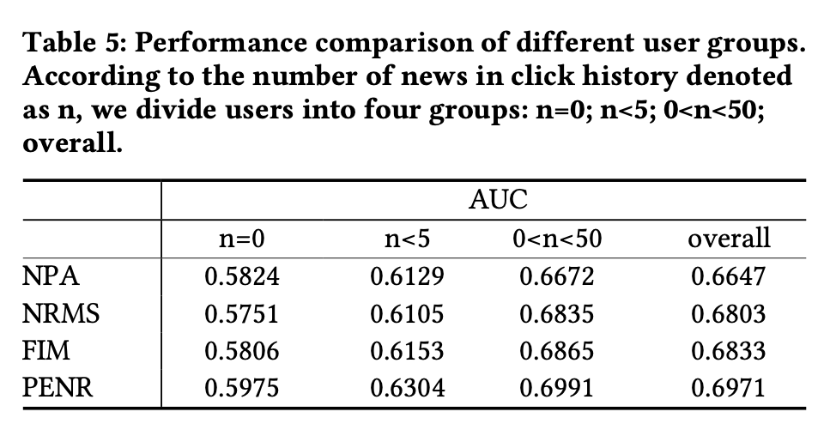
Experiment

Slide 33
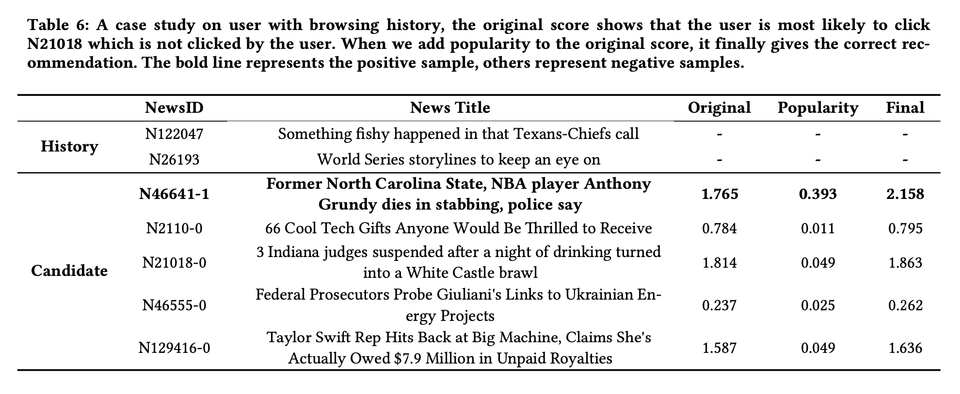
Experiment

Slide 34
Outline
Introduction
Method
Experiment
Conclusion

Slide 35
Conclusion
propose the PENR model
introduces news popularity
enhances user interest representation in multiple perspectives

